Slide 1
Lecture 1: COMP1010 Introduction to Programming
Course content, Organization and Basic Concepts
Pham Huy Hieu and Kok-Seng Wong | Fall 2025
College of Engineering and Computer Science, VinUniversity
September 16th, 2025
Notes:
Good afternoon everyone, welcome all of you to VinUni and welcome to the class COMP1010: Introduction to Programming. My name is Hieu Pham and I am really excited to be your instructor in this course. In today’s session I will give you a course introduction that cover course content, organization and basic concepts of a computer system. I hope by the end of this course you’ll see how programming can be both powerful and fun.

Slide 2
OUTLINE: PLAN FOR TODAY
Course organization and logistics
Learning objectives and expected learning outcomes
Introduction to computer systems (hardware, software, components of a computer system)
Notes:
So, for today, we’ll start by looking at how the course is organized and some important logistics. Then, we’ll go over the learning objectives—what skills and knowledge you’re expected to gain. Finally, I’ll give you a first look at computer systems, including hardware, software, and the main components that make them work together.

Slide 3
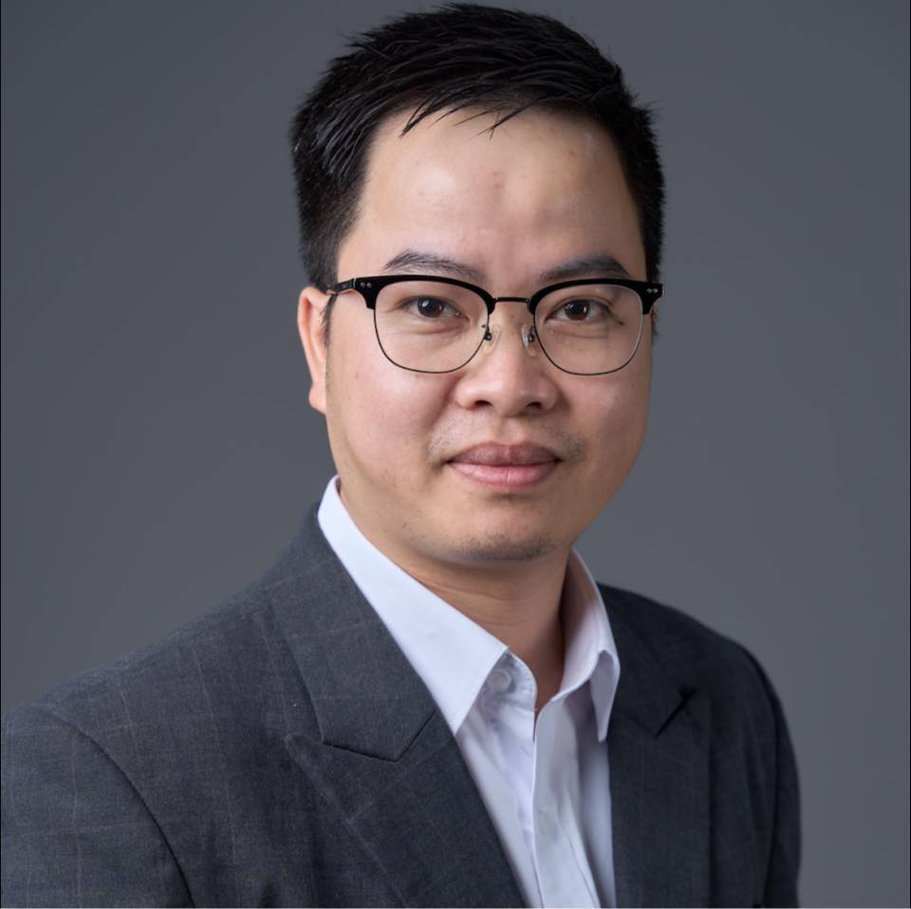
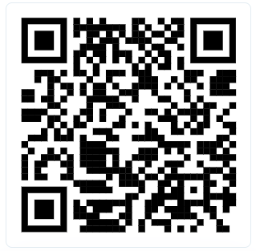
Teachng Team
About the Instructor
Ph.D. in Computer Science, Univ. of Toulouse, France (2019).
Research Scientist and Head of Fundamental Research at Medical Imaging Center, Vingroup Big Data Institute (2019 - 2021)
Assistant Professor, CECS, VinUniversity (present)
Principal Investigator (PI), VinUni-Illinois Smart Health Center, VinUniversity. Head of Computer Vision and Medical AI Lab (present)
Deputy Director of Research Management Office @ VinUni (present)
Research Interests: Computer Vision, Artificial Intelligence, Machine Learning, Deep Learning, Medical Image Analysis, and Smart Healthcare.
Room: G-313 – VinUni-Illinois Smart Health Center (VISHC)
Academic webpage: https://huyhieupham.github.io/
Google Scholar: https://shorturl.at/wxzJ8
Email: hieu.ph@vinuni.edu.vn
Scan to learn more about our research
Notes:
Introduce the instructor

Slide 4
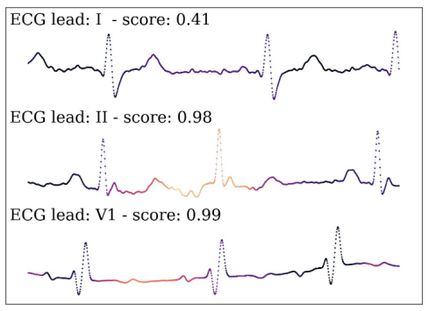
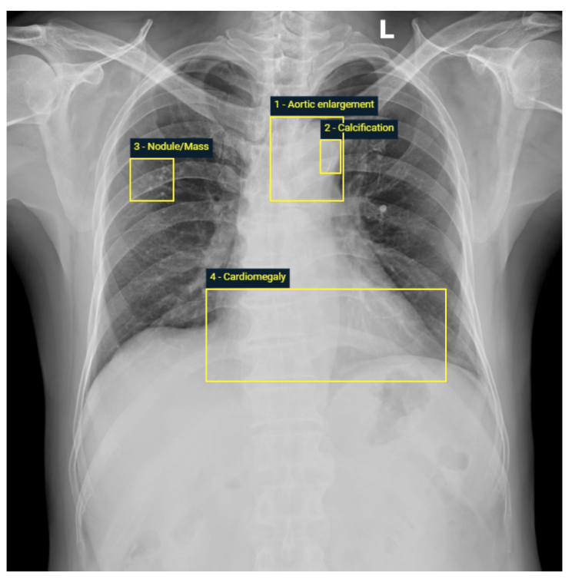
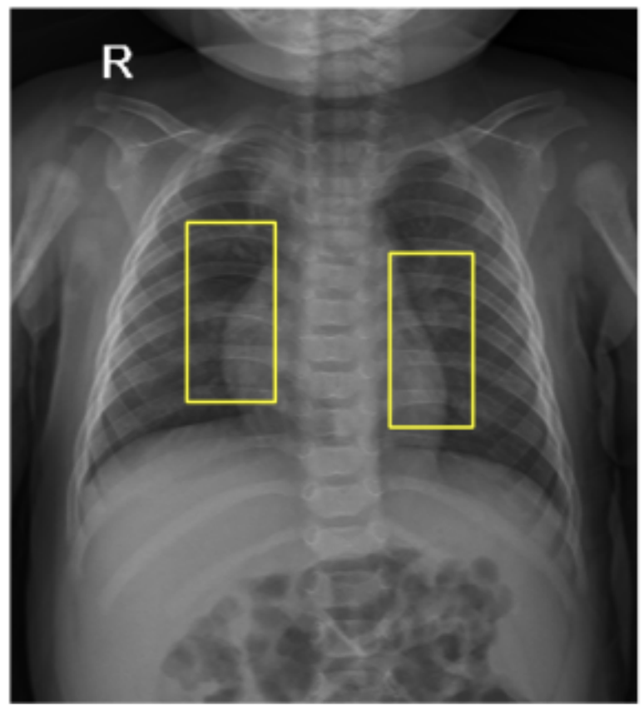
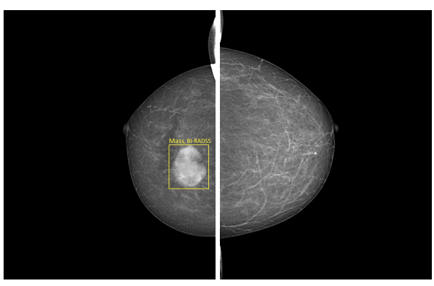
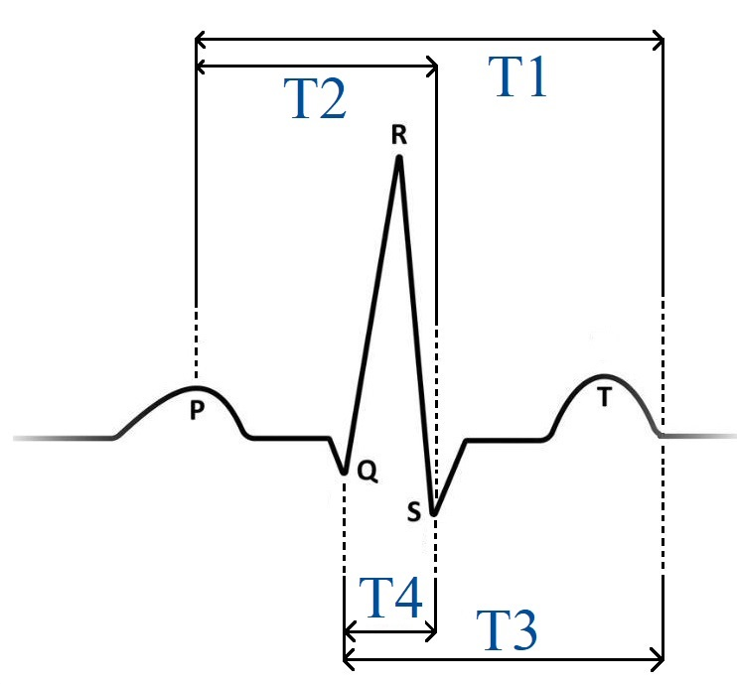
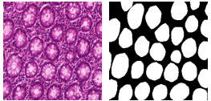
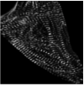

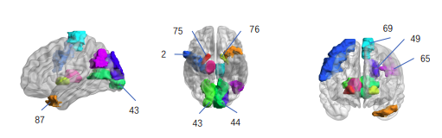
My Research in AI for Healthcare
Medical Image Analysis
Medical Image Analysis
Biosensing AI
Biosensing AI
AI for cancer screening in radiology (Hieu Pham et al, Neurocomputing 2022 & PLOS 2023)
ECG-based Sleep Apnea Detection using AI (Hieu Pham, Cuong Do et al, IEEE Journal of Biomedical and Health Informatics 2024)
Computational Cell Analytics
Computational Cell Analytics
NeuroImaging
NeuroImaging
Understanding Alzheimer’s Disease based on fMRI (Bowen Hu, Hieu Pham et al, IEEE Transactions on Emerging Topics in Computational Intelligence 2025)
Cell Counting and Structural Quantification (Hieu Pham & Huyen Le, IEEE ISBI 2024)
Notes:
Introduce my research

Slide 5
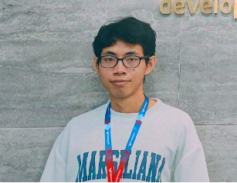

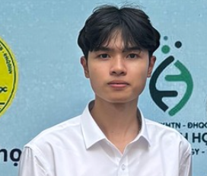
Teaching assistants
Pham Quoc Cuong, PhD Student
Office: G-Building, Open Lab 1,
VinUni-Illinois Smart Health Center
Email: 24cuong.pq@vinuni.edu.vn
Nguyen Hai Dang, PhD Student
Office: G-Building,Open Lab 1,
VinUni-Illinois Smart Health Center
Email: TBD
Nguyen Trong Duc, PhD student
Office: G-Building, Open Lab 1,
VinUni-Illinois Smart Health Center
Email: TBD
Teaching Assistants (TAs) play an important role in supporting both instructors and students in a course. Helping deliver tutorials, lab sessions, or discussion sections, assisting with grading assignments, quizzes, and providing constructive feedback. Running office hours to answer questions and provide additional explanations, etc.
Notes:
Let me introduce our Teaching Assistants for COMP1010. They’re here to support you throughout the course. What they can do, they can help deliver tutorials, labs, quizzes, or just answering your questions. We have Pham Quoc Cuong, Nguyen Hai Dang, and Nguyen Trong Duc— all PhD students at the VinUni-Illinois Smart Health Center, VinUniversity. Their office is in 3rd floor, G-Building, Open Lab 1. You’ll also be able to reach them by email, and they’ll share office hours for extra support.

Slide 6
Course organization and logistics
Notes:
Okay now let take a look at the course organozation and logictics.

Slide 7
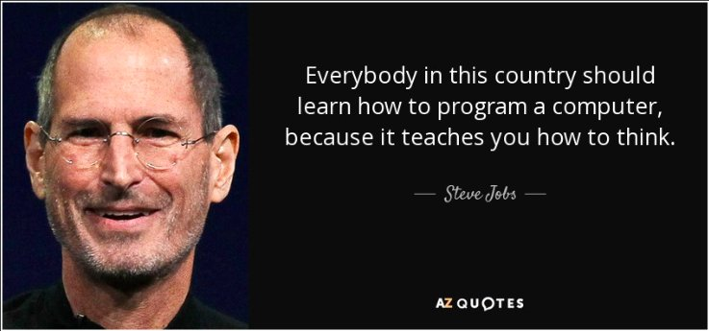
Course description
Course Information
This course is an introductory programming course taught to all students.
It provides students with the basic programming skills and a basic understanding of the design of programming languages.
4 credits, required course, no prerequisite/co-requisite/exclusion courses.
[source]
Notes:
Now let me give you a quick overview of this course. This is an introductory programming course designed for all students. The main goal is to help you gain basic programming skills and a fundamental understanding of how programming languages are designed.
The course carries 4 credits and is a required course. Importantly, there are no prerequisites, co-requisites, or exclusion courses — meaning you don’t need to take any other course before, alongside, or instead of this one.

Slide 8
Learning goals
Understand and apply the basic concepts of programming including variables, classes, loops, functions, arrays, vectors, exceptions and the basics of object-oriented programming (OOP) and graphical user interfaces.
Acquire fundamental programming skills required to engage in more complex computer science topics.
Develop the ability to solve conceptual and application-based computing problems via regular practice, both in and out of class.
Notes:
There are three main and very important learning goals for this course. First, second and last.

Slide 9
Specific learning objectives
By the end of this course, students will:
Use programming language constructs such as primitive types and classes.
Understand the basics of object-oriented programming, algorithms, and data structures.
Work with function calls.
Create and understand recursive functions.
Work with arrays, lists, and dictionaries, strings.
Develop basic graphic user interfaces (GUI).
Choose an adequate programming style and write good code.
Use the Python library for fundamental machine-learning tasks.

Slide 10

Why DO we start with PYTHON?
Notes:
Many students from previous cohorts asking us why do we start with Python? Do you know why?

Slide 11
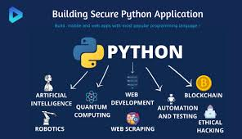
Key advantages of python
Python has risen in the ranks of programming languages.
Easy to learn and readable syntax.
Diverse community that opens new opportunities.
Python has extensive libraries and frameworks.
Source https://bullayyacollege.org/org/
Further reading: https://www.nextacademy.com/blog/learn-python-first/

Slide 12
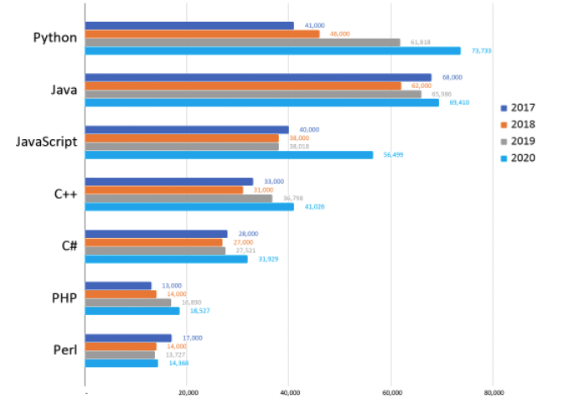
Key advantages of python
Python extends its lead as the most popular programming language
[source]

Slide 13
Class schedules
Lectures
Weekly Laboratory
Group | Day & Time | Venue
All Students | Tuesday: 1.30 – 2.45 pm | D302
 | Wednesday: 1.30 – 2.45 pm | D302
Group | Day & Time | Venue
1 (IPRF253) | Thursday : 1.30 - 3.20 pm | G102 (SuperLab)
2(IPRFA254) | Thursday : 1.30 – 3.20 pm | G102 (SuperLab)

Slide 14
Office hours
Group | Day & Time | Venue
All students | Tuesday: 5.00 – 6.00 PM | G-Building, Open Lab 1, VISHC
 | Thursday: 5:00 – 6.00 PM

Slide 15
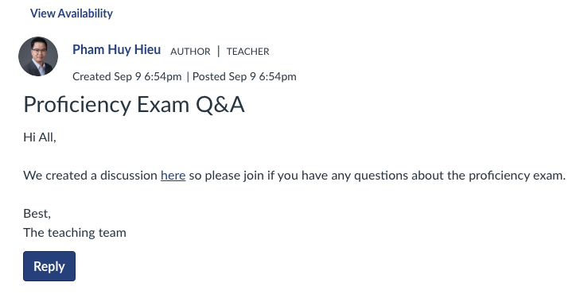
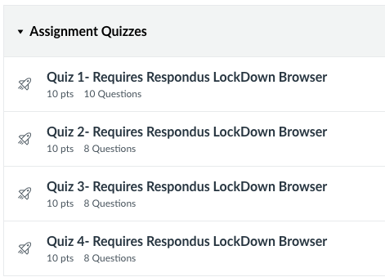
Active learning methods
Tools: Canvas is used for managing the whole course.
During laboratories, students engage in program development and discussion with TAs who facilitate the laboratory work.

Slide 16
Course logistics
Lectures will be held in lecture rooms with at least two projectors of high quality.
The course will utilize Canvas for the blended learning component.
Course announcements and course material distribution will be made available in Canvas.
In laboratories, students use the programming environment of their choice (the Anaconda version of Python is suggested, but the instructor will make that final choice at the beginning of the semester).

Slide 17
Late submission policy
Late submission of lab practices without an approved extension will incur the following penalties:
No submission by the deadline will incur a 0.25-point deduction for each problem (most of the problems are due at the end of the lab session).
The instructor will deduct an additional 0.25-point per problem for each day past the deadline.
The penalty will be deducted until the maximum possible score for the lab practice reaches zero (0%) unless otherwise specified by the instructor.

Slide 18
Other requirements
For other course requirements, including late submission for assignments, exams, instructor expectations and academic integrity, please refer on the Canvas system under “Syllabus”.

Slide 19
Course readings (Optional)
Downey, A. B. (2015) Think Python: How to Think Like a Computer Scientist. Retrieved from greenteapress.com
Guttag, J. (2016) Introduction to Computation and Programming Using Python: With Application to Understanding Data. USA: MIT Press.

Slide 20
Grading procedures
Item | Assessment Method | % Weighting
1. Attendance | Class Attendance & Participations | 5%
2. Quizzes | Theory Questions (4) | 10%
3. Assignment | Video Presentations (2) & Problem Sets Design (2) | 10%
4. Weekly Laboratory | Hands-on Programming Assignments | 20%
5. Midterm Exam | Theory & Hands-on (Practical) | 25%
6. Final Exam | Theory & Hands-on (Practical) | 30%
Total |  | 100%
Notes:
You will take online quizzes during labs/lectures. Each quiz might consists of multiple-choice, true/false, short-answer, and problem-solving questions.

Slide 21
Grading scheme
Grade | Range
A | 100% | to 89.5%
A- | <89.5% | to 84.5%
B+ | <84.5% | to 79.5%
B | <79.5% | to 74.5%
B- | <74.5% | to 69.5%
C+ | <69.5% | to 64.5%
C | <64.5% | to 59.5%
C- | <59.5% | to 54.5%
D+ | <54.5% | to 49.5%
D | <49.5% | to 44.5%
D- | <44.5% | to 40.0%
F | <40.0% | to 0.0%
Notes:
Here is the offitical grading scheme of this course. This scheme will be also applied for all courses at CECS. You will get A

Slide 22

How many of you will participate in the Proficiency test?

Slide 23
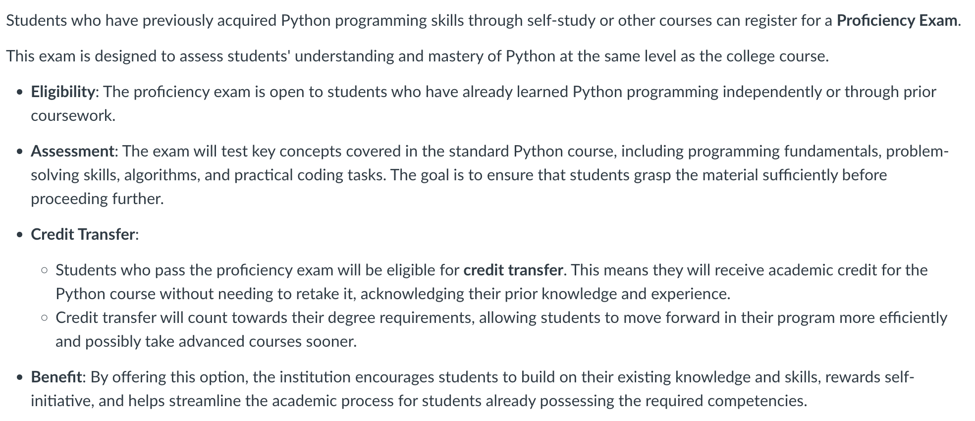
Proficiency exam (For CECS Students)

Slide 24
Introduction to computer systems
Hardware, Software, Components of a Computer System
Notes:
Now let’s move to the next part of today’s session: An introduction to computer systems. I will give you a quick introduction to computer systems. We will talke about hardware, sofware, and some key compotents of a computer system. By the end of this section, you should understand what happens inside a computer system when you run a program to accomplish a specific task.

Slide 25
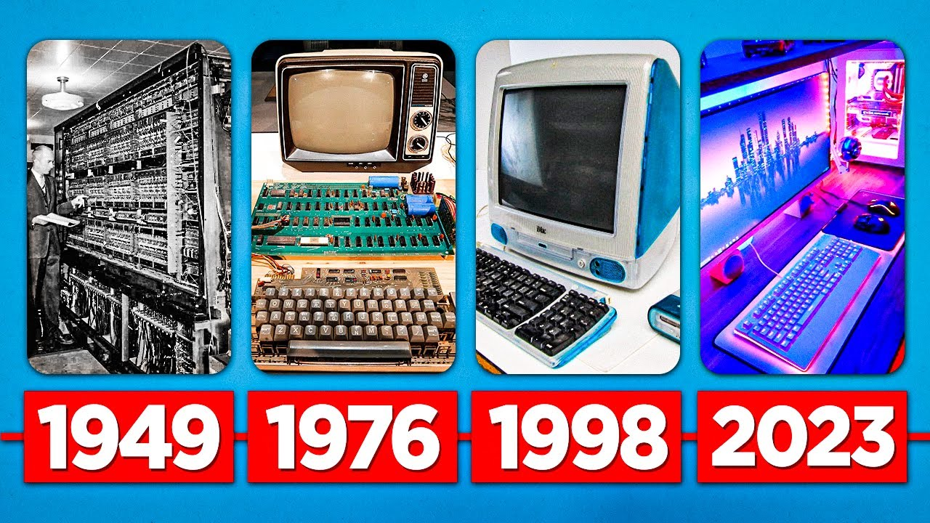
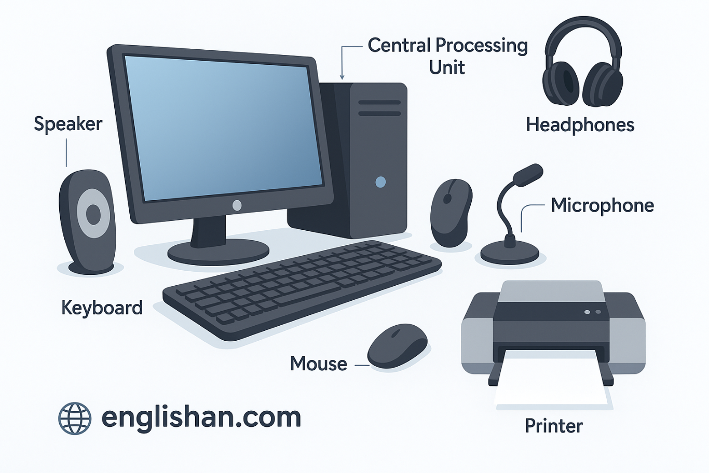
Computer hardware
The physical parts of the computer: Input devices (keyboard, mouse, microphone, etc), output devices (monitor, speakers, etc), storage devices (HDD, SSD, etc), CPU, RAM and networking components (NIC, adapter, ports, etc).
Source
Source

Slide 26
Computer software
The programs and data used with the physical computer:
System Software
Application Software
Utility Software
Computer Security

Slide 27
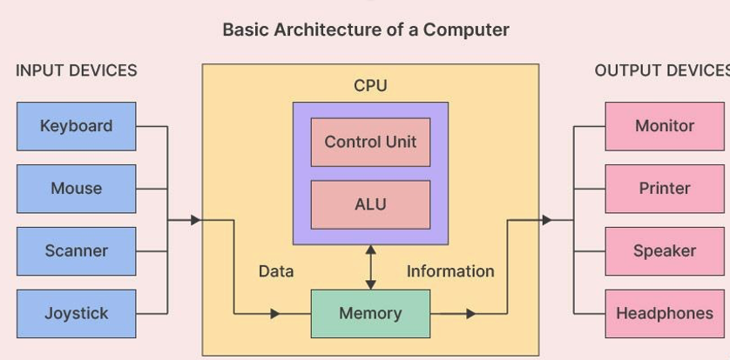
Major components of a computer system
Processor
Main memory
Secondary memory
Input devices
Output devices
Disk storage
[source]

Slide 28
What is a Computer program?
Notes:
Many students from previous cohorts asking us why do we start with Python? Do you know why?

Slide 29
What is a computer Program?
A program is a sequence of instructions that specifies how to perform a computation.
input
output
math/logic
conditional execution
Repetition/recursion

Slide 30
Types of programs
Application Programs | Systems Programs
Word processors Games Spreadsheets Database systems Graphics programs Web browsers | Operating system Networking system Programming language software Website server Data backup

Slide 31
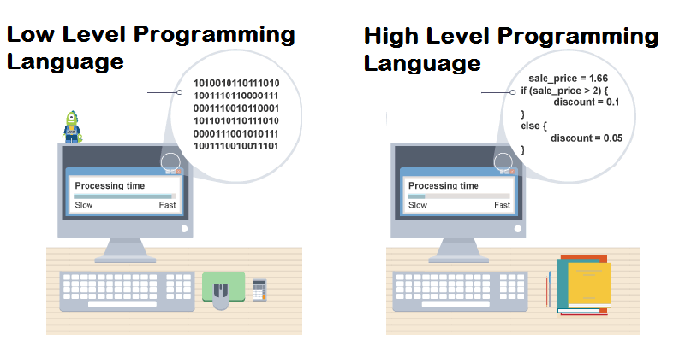
Programming language
assembly language, machine languages
C, C++, Perl, Java, Python, …
[source]
Computers can only execute programs written in low-level languages.
Thus, programs written in a high-level language have to be processed before they can run.

Slide 32
Low-level vs high-level
Programs written in a high-level language
  Less time to write.
  Shorter and easier to read.
  More likely to be correct.
  Portable: can run on different kinds of computers with few or no modifications.
  Low-level programs can run on only one kind of computer and have to be rewritten to run on another.

Slide 33
Interpreter vs. compiler
What happens when you write and execute a computer program?

Slide 34
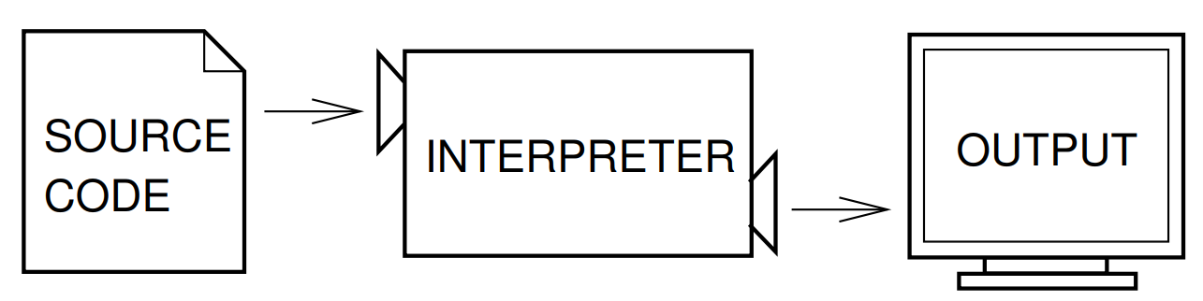
Interpreter
An interpreter reads the source code line by line and executes it immediately.
It processes the program a little at a time, reading lines and performing computations

Slide 35
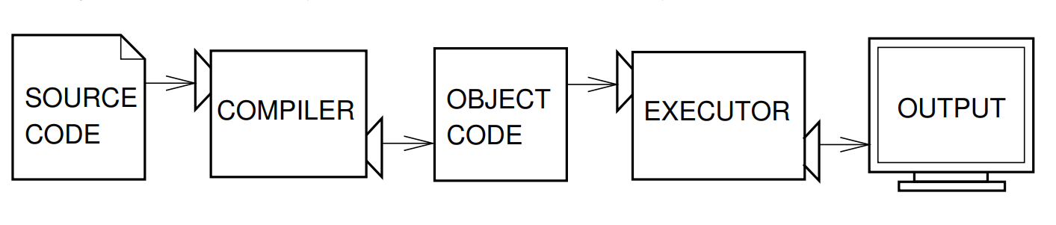
compiler
A compiler reads the whole program and translates it completely before the program starts running.
In this case, the high-level program is called the source code, and the translated program is called the object code or the executable.
Once a program is compiled, you can execute it repeatedly without further translation.
Notes:
Translates the entire source code into machine code first, creating an executable file. The computer then runs this file.

Slide 36
Lecture 02: Introduction to Python Programming
Thank you for your attendance!

